Slide 1
HR Analysis
Here is where your presentation begins

Slide 2
Table of contents
01
02
03
04
Introduction
Data Exploration
Data Overview
Understand the data and make it ready to analyze
CONCLUSION
Dashboard Using PowerBI
Identifying mathematical concepts in real-world scenarios
Some Recommendations For Stakeholders

Slide 3
01
Introduction

Slide 4
Introduction
This HR data analysis project aims to uncover patterns in employee performance, satisfaction, and turnover by analyzing past HR data.
Data Set Attributes:
Employee information
Performance ratings
Education levels
Rating categories
Satisfaction levels
Project Objective: The goal is to deliver insights that will guide management in making data-driven decisions to enhance employee retention and performance.

Slide 5
02
Data Exploration

Slide 6
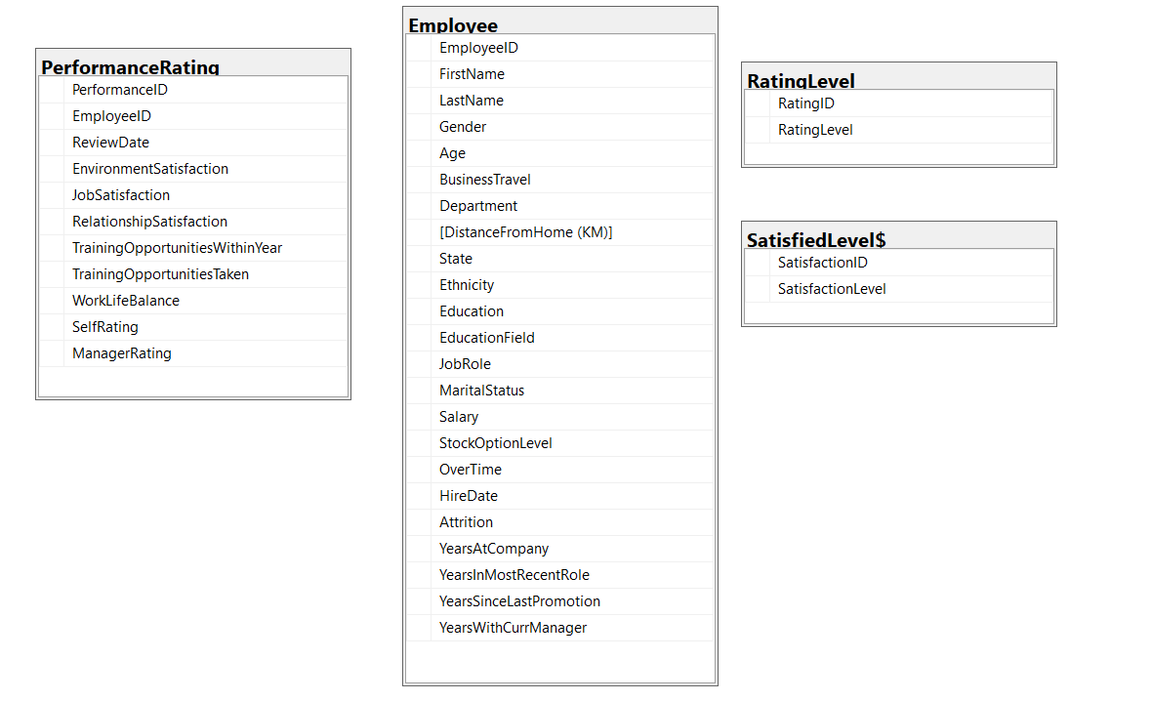
Raw Data In SQL

Slide 7
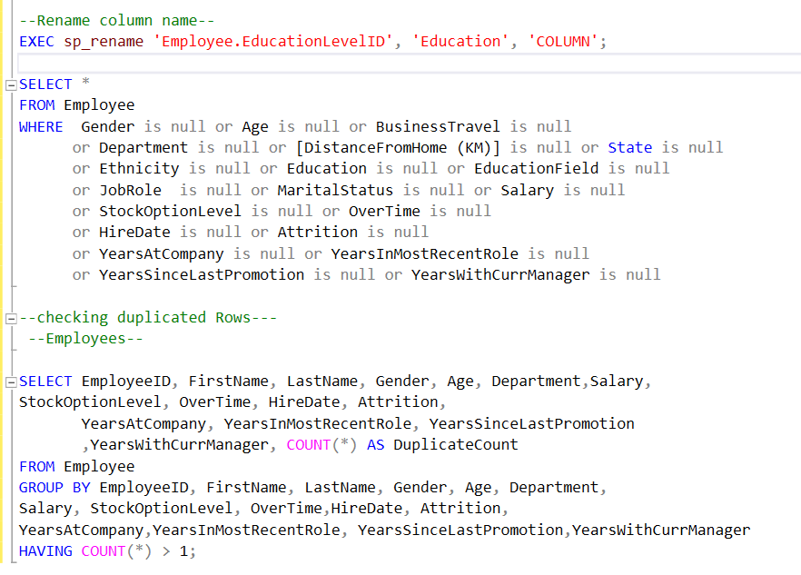
Renaming Columns And Checking Nulls & Dublicates

Slide 8
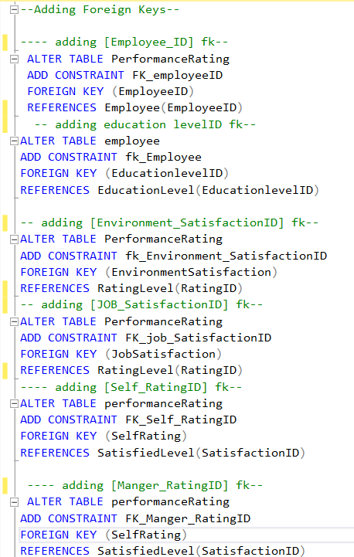
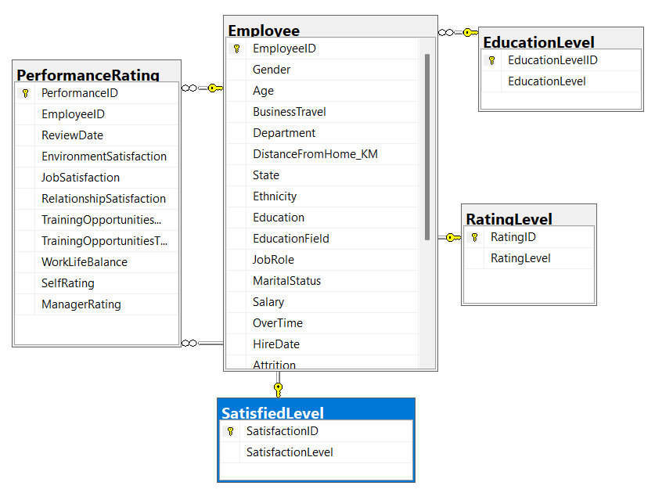
Adding Foreign Keys

Slide 9
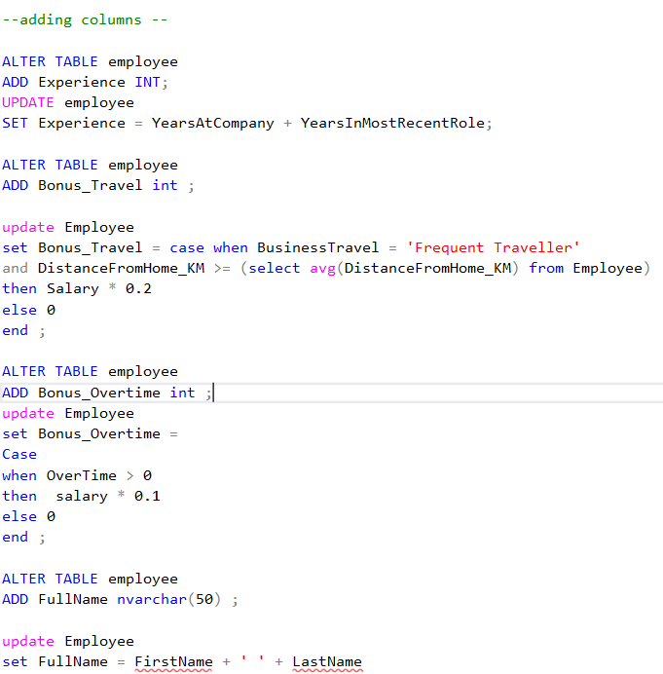
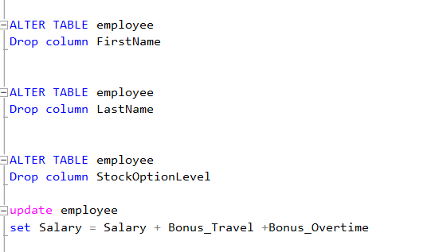
Adding New Column And Dropping Unnceceasry Columns

Slide 10
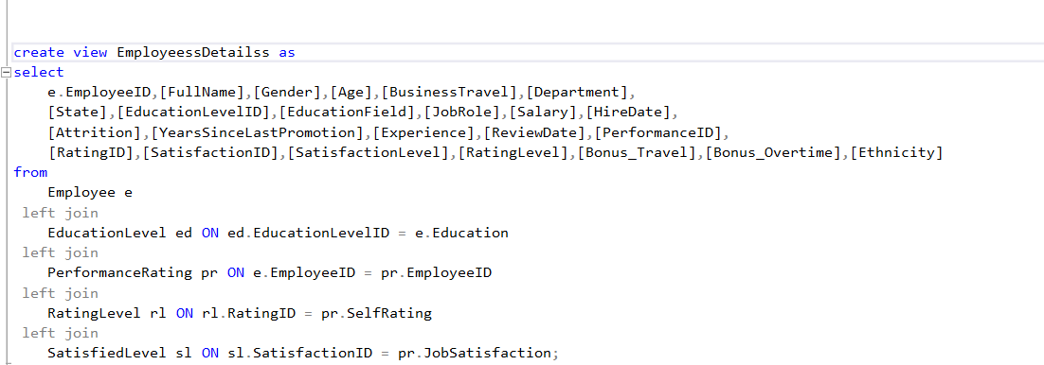

Create View To Import in PowerBi

Slide 11
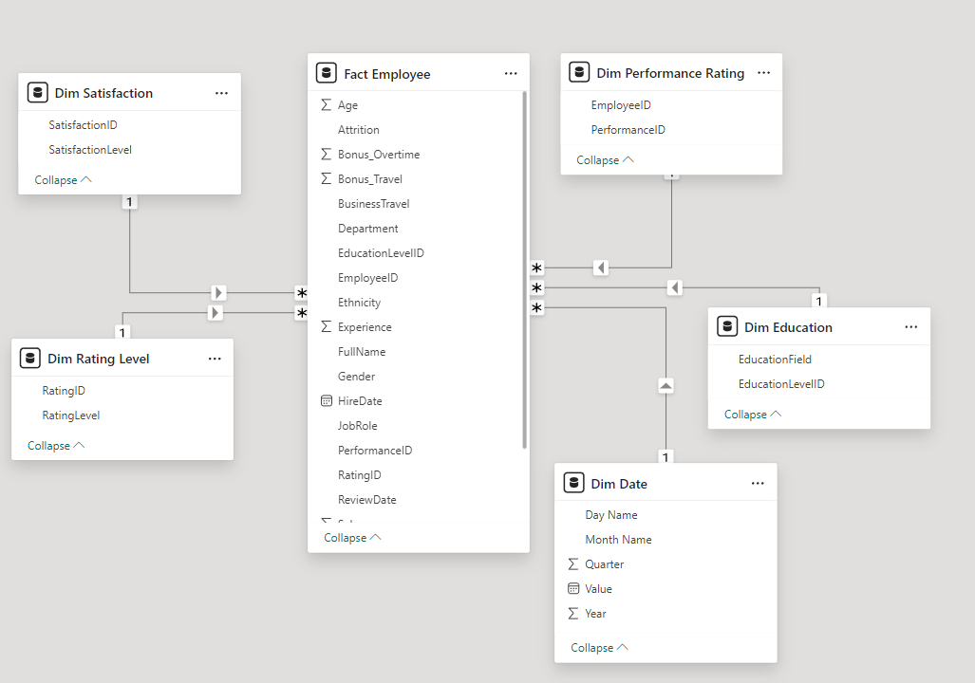
Star Schema In PowerBi

Slide 12
03
Dashboard

Slide 13
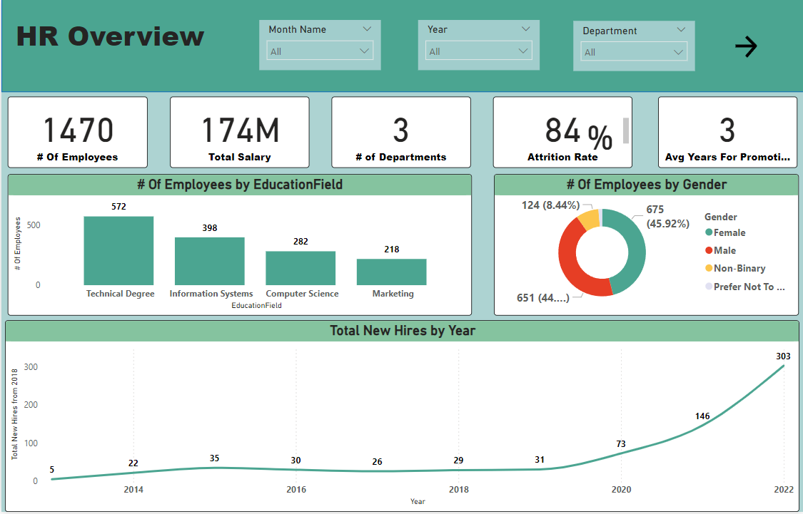

Slide 14
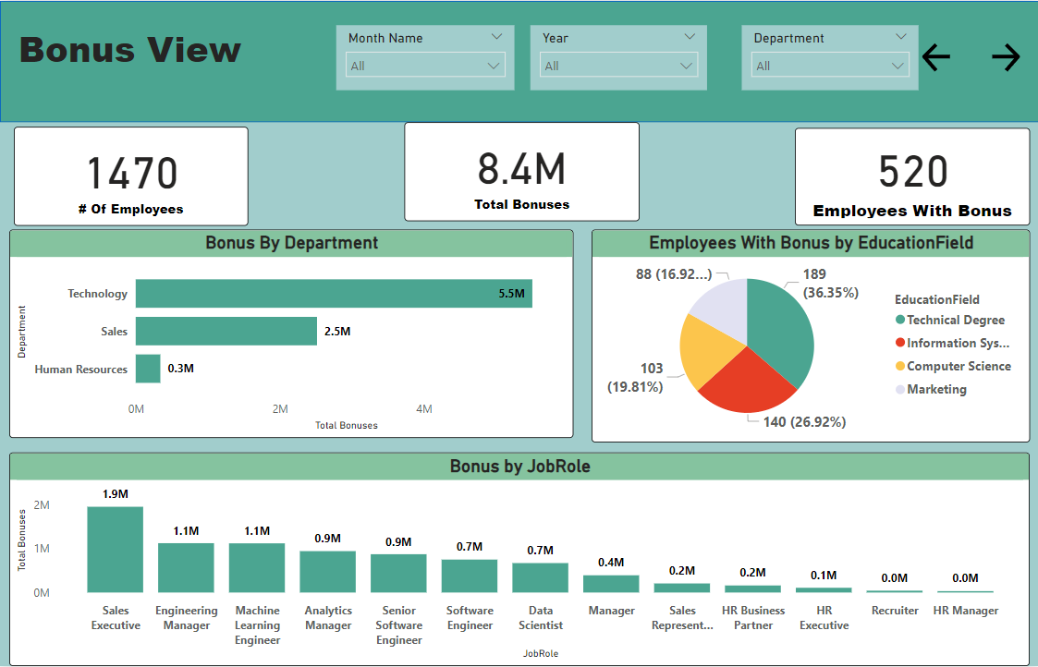

Slide 15
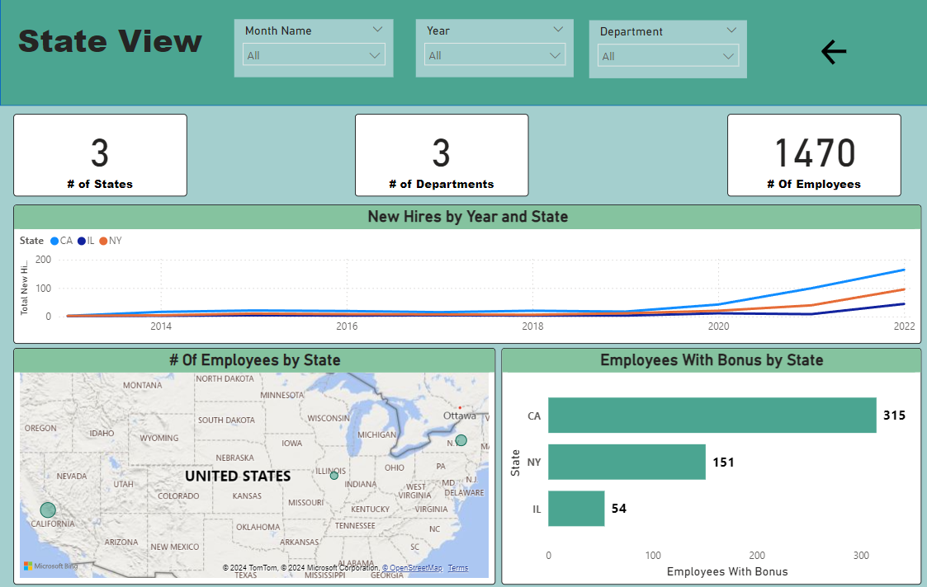

Slide 16
04
Conclusion

Slide 17
Recommendations
Reduce High Employee Turnover: Look into why 84% of employees are leaving by using surveys and exit interviews. Take steps to keep employees happy and reduce the number of people leaving.
Balance Hiring and Retention: Since there have been more new hires since 2018, focus on better onboarding, mentoring, and development programs to keep new employees and help them grow within the company.

Slide 18
Thanks!

